Slide 1

CU6051NI Artificial Intelligence
Breast Cancer Detection
Student: Anurodh Prasain
London Met ID: 23047512
Submitted To: Mr. Alish KC
Due Date: December 17, 2025

Slide 2
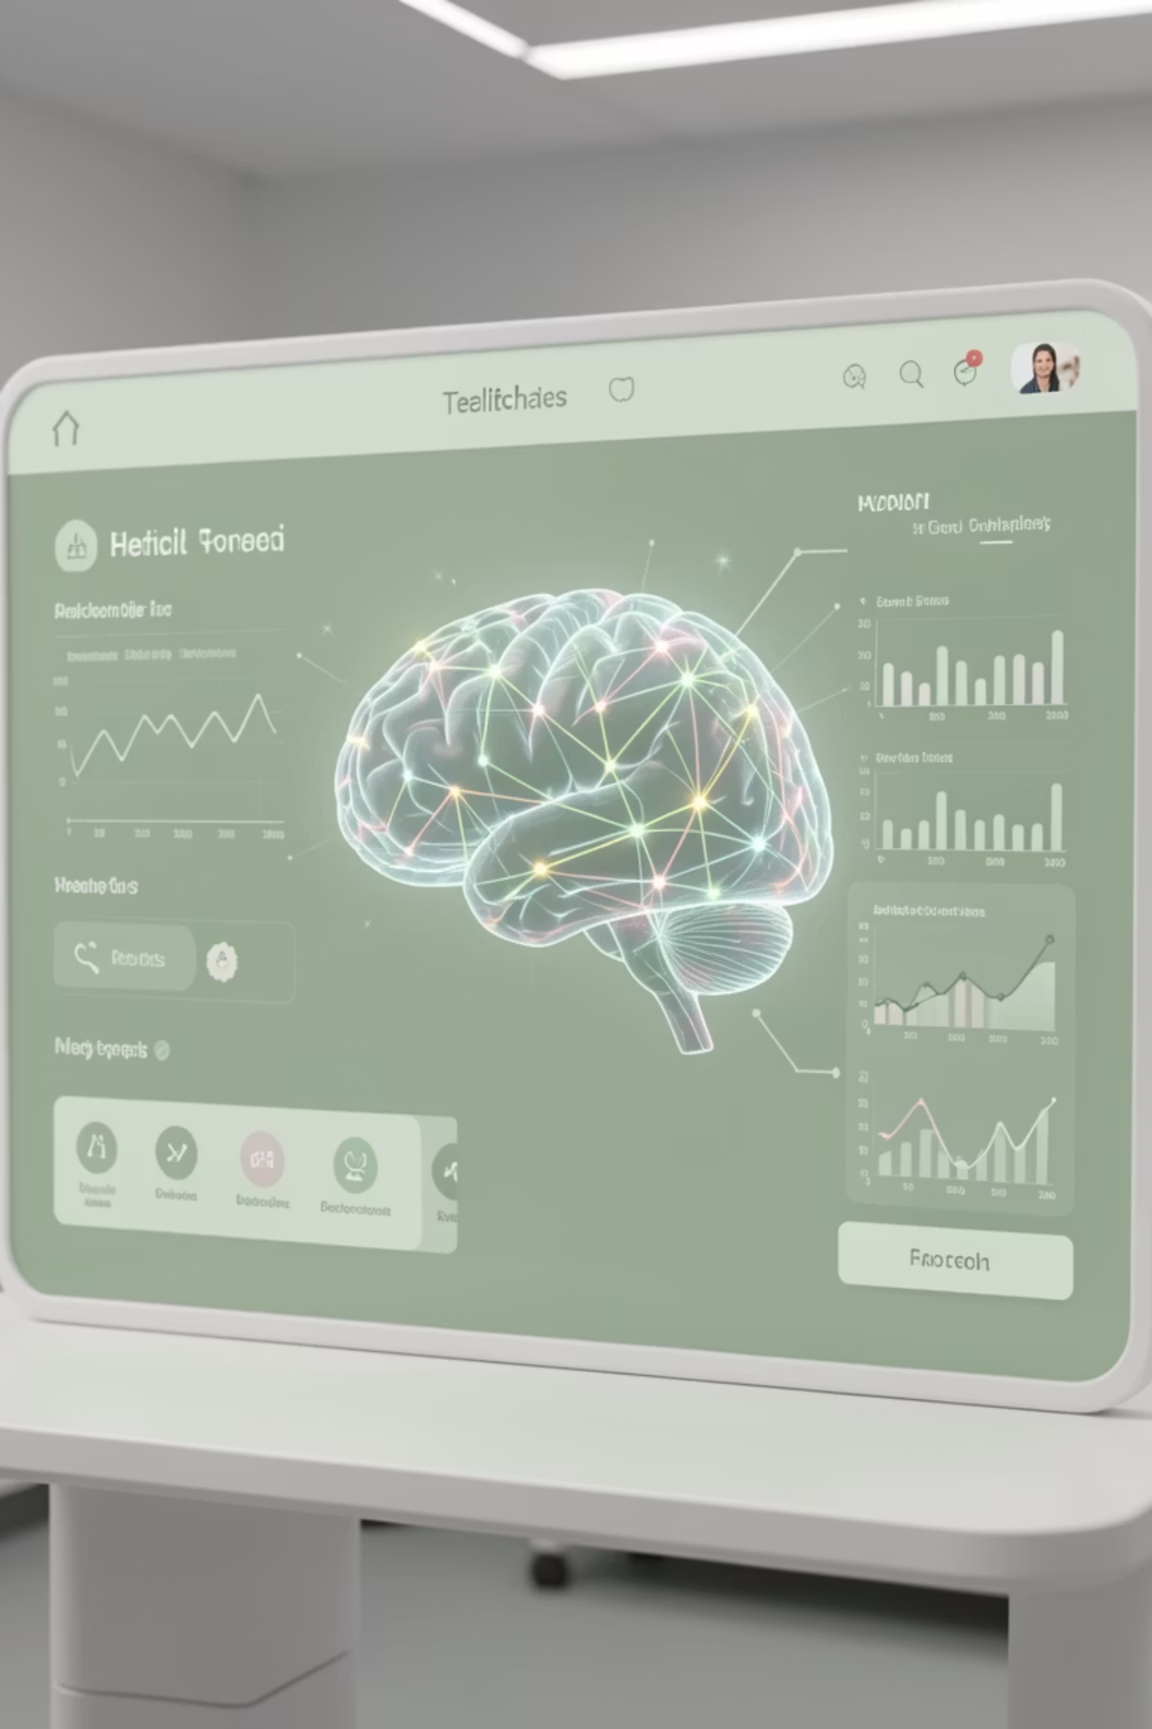
INTRODUCTION
AI & Machine Learning in Healthcare
Artificial Intelligence (AI) provides computers with human-like capabilities to learn, reason, and analyze data. Machine Learning (ML), a subdivision of AI, enables algorithms to learn from data and make predictions without explicit programming.
1
2
Supervised Learning
Unsupervised Learning
Trains models to predict correct outputs based on labeled data, used for classification or regression.
Identifies patterns and dependencies in unlabeled data without external ground truth.
3
Reinforcement Learning
Trains models to make decisions that maximize rewards in dynamic environments.

Slide 3

PROBLEM DOMAIN
Breast Cancer Diagnosis: A Critical Challenge
Breast cancer is a leading cause of death among women globally. Early diagnosis significantly improves survival rates and reduces healthcare costs. Machine learning offers a powerful tool to aid clinical decision-making by identifying diagnostic patterns from patient data and medical images.
Traditional Methods
Biopsy, mammography, and histopathological analysis are time-consuming, resource-intensive, and prone to human variability.
ML Promise
Supervised learning frameworks like Logistic Regression, KNN, and Decision Trees classify tumors based on features like cell size, texture, and morphology.

Slide 4
PROJECT OBJECTIVES
Developing an AI-Powered Diagnostic System
This project aims to leverage supervised machine learning to enhance breast cancer diagnosis. We will explore and compare various algorithms to identify the most effective model for this critical task.
01
02
03
Understand ML Fundamentals
Implement Algorithms
Measure & Compare Performance
Grasp supervised machine learning classification principles.
Apply Logistic Regression, KNN, and Decision Tree classifiers to the dataset.
Evaluate algorithms using relevant metrics to determine efficacy.
04
05
Identify Best Model
Prove Practical Relevance
Determine which model offers the most accurate breast cancer prediction.
Demonstrate the utility of supervised learning in medical decision support.

Slide 5





PROPOSED SOLUTION
Smart Breast Cancer Diagnosis System
Our proposed system uses supervised machine learning to categorize tumors as malignant or benign based on medical imaging data. This systematic approach ensures robust and reliable predictions.
Data Acquisition & Preprocessing
Clean data, remove irrelevant attributes, handle missing values, and normalize features.
Data Splitting
Divide data into training and testing sets for model development and validation.
Model Training
Train Logistic Regression, Decision Tree, and KNN classifiers.
Performance Evaluation
Assess models using accuracy, precision, recall, and F1-score.
Decision Support
Deploy the most effective model for early breast cancer diagnosis.

Slide 6




ALGORITHMS EXPLAINED
Key AI Algorithms for Classification
This project utilizes three supervised learning algorithms, each with unique strengths, to classify breast tumors.
Logistic Regression
A statistical classification technique for binary outcomes, providing probabilities and interpretable coefficients. Ideal for understanding feature effects.
Decision Tree Classifier
A rule-based model that divides datasets based on characteristic thresholds, creating clear decision pathways. User-friendly and visualizable.
K-Nearest Neighbors (KNN)
An instance-based learning algorithm that classifies based on the proximity of nearest instances in feature space, using similarity measurements.

Slide 7
DEVELOPMENT PROCESS
From Data to Model: A Step-by-Step Journey
Our development process ensures data integrity, optimal feature preparation, and robust model training for accurate breast cancer diagnosis.
Data Acquisition & Loading
1
Importing the dataset and verifying its structural integrity.
2
Structural Inspection
Checking dataset shape, column names, and data types.
Data Quality Assessment
3
Analyzing missing values and removing null columns.
4
Statistical Data Understanding
Descriptive statistics, target variable, and feature distribution analysis.
Outlier Detection
5
Identifying extreme values using boxplot visualization.
6
Feature Preparation
Encoding target variable, separating features, and scaling.
Data Partitioning
7
Splitting data into training (80%) and testing (20%) sets.

Slide 8
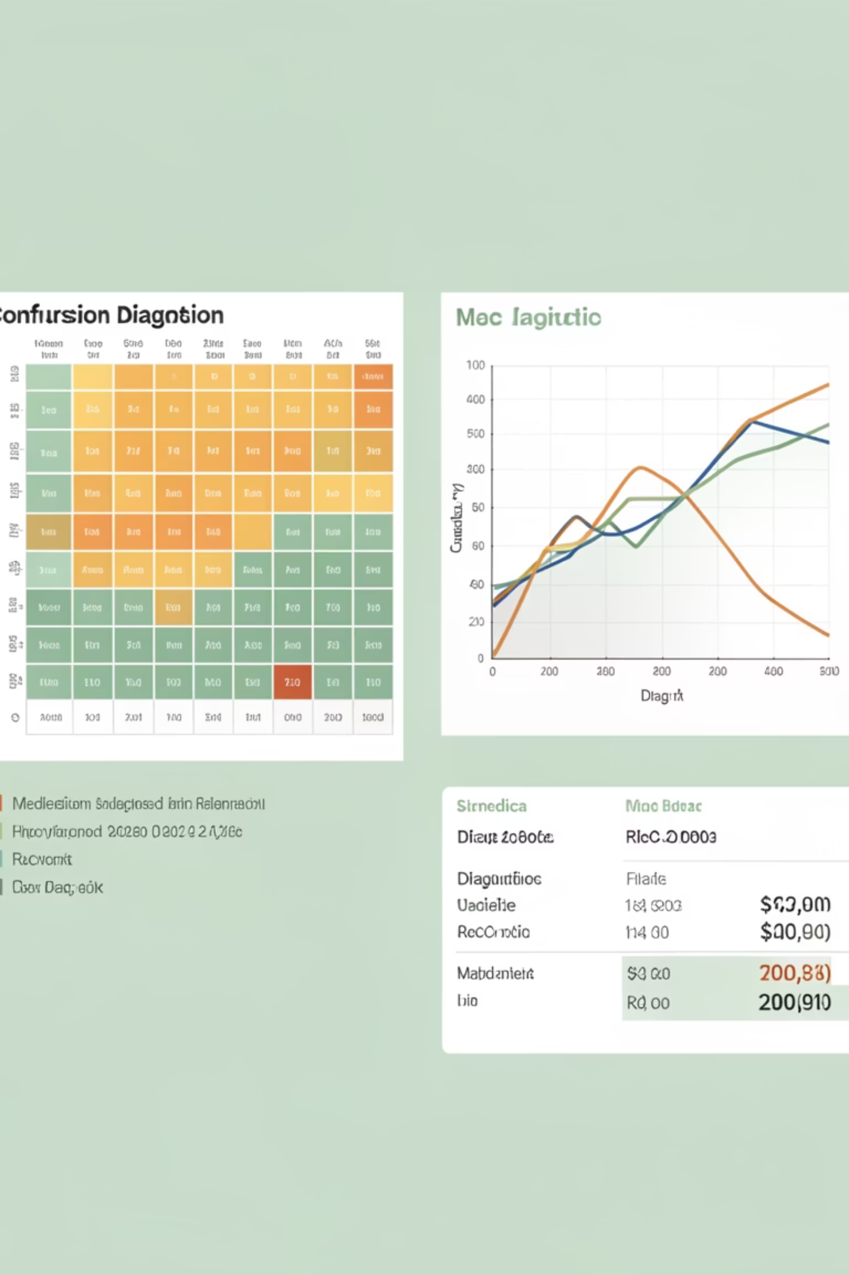
MODEL IMPLEMENTATION
Logistic Regression: Optimized for Safety
We conducted multiple trials to fine-tune Logistic Regression, prioritizing high recall and low false negatives for medical diagnostic safety.
Trial 1: Default Parameters
Trial 2: Strong Regularization (C=0.01)
Accuracy: 0.9737, Recall: 0.9535. Good baseline, but recall needs improvement.
Accuracy: 0.9825, Recall: 0.9767. Highest accuracy and F1-score, with only 1 false negative. Most effective for clinical safety.
Trial 3: Optimized (C=10)
Accuracy: 0.9737, Recall: 0.9767. High recall, but slightly reduced precision.

Slide 9
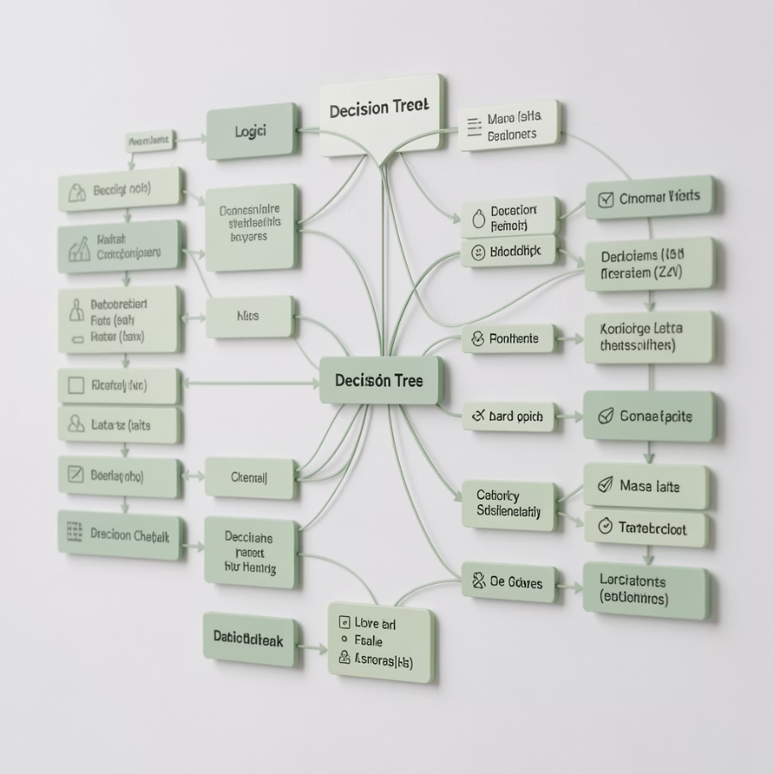

MODEL IMPLEMENTATION
Decision Tree & KNN: Performance Insights
Decision Tree and K-Nearest Neighbors models were also rigorously tested and optimized, revealing their strengths and limitations in breast cancer diagnosis.
Decision Tree Classifier
K-Nearest Neighbors (KNN)
Trial 1: Unlimited Depth
Trial 1: k=1
Overfitted, high training accuracy but low test accuracy (0.9474). Not reliable.
Highly sensitive to noise, low test accuracy (0.9386). Overspecifies training data.
Trial 2: Shallow Depth (max_depth=3)
Trial 2: k=5
Underfitted, poor recall (0.9070). Too simplistic for complex interactions.
Improved generalization, better recall than k=1. Moderate performance (0.9474).
Trial 3: Optimized (max_depth=5, min_samples_leaf=2)
Trial 3: Optimal k=9 (weighted)
Highest accuracy (0.9649) and F1-score (0.9535) for KNN. Good recall and low false negatives. Computationally intensive for large datasets.
Best accuracy (0.9561) and F1-score (0.9412) for Decision Tree. Better, but less stable than Logistic Regression.

Slide 10

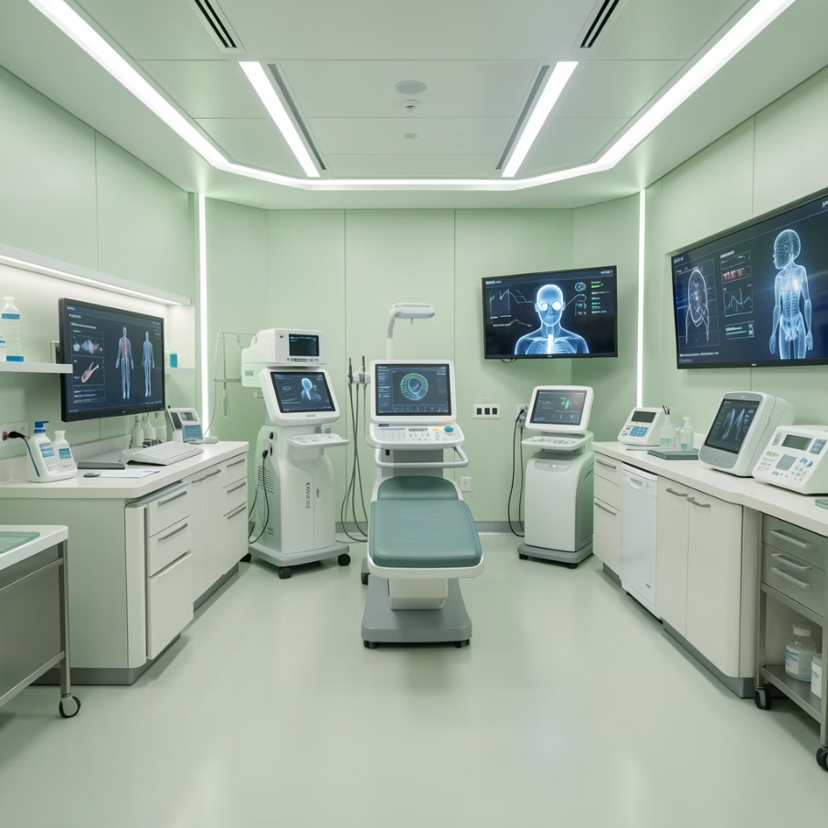
CONCLUSION & FUTURE WORK
The Future of Breast Cancer Diagnosis with AI
Our analysis confirms that machine learning algorithms are highly effective in breast cancer diagnosis. The Logistic Regression model (Trial 2: C=0.01) stands out as the most reliable and clinically safe option.
0.9825
0.9767
1
Accuracy
Recall
False Negatives
Logistic Regression (Trial 2)
Logistic Regression (Trial 2)
Logistic Regression (Trial 2)
Final Recommendation
Future Work
The Logistic Regression model (C=0.01, solver=liblinear) is recommended for its superior recall, minimal false negatives, high accuracy, and interpretability. It aligns with the ethical imperative of healthcare AI by prioritizing patient safety and providing reliable diagnostic assistance.
Future steps include full application of models in Python, exploring advanced algorithms like Random Forests and deep learning, and integrating the system into real-time clinical environments. Further research into feature selection and dimensionality reduction will optimize performance and computational efficiency.

